Slide 1

Analysis of Reliability and Resilience for Smart Grids
Murtadha Albasrawi, Kamlesh Joshi, Nathan Jarus, Dr. Sahra Sedigh
Missouri S&T Dept. of Electrical and Computer Eng.
Notes:
Abstract: This paper illustrates the use of software for monitoring and recording the effects of electrostatic discharge (ESD) on the operation of embedded systems, with the goal of facilitating root-cause analysis of resulting failures. Hardware-based scanning techniques are typically used for analyzing the effect of ESD on systems by identifying physical coupling paths. This paper proposes software techniques that monitor registers and flags associated with peripherals of embedded
systems to detect faults associated with the effects of ESD. A lightweight, cost-effective, and non-intrusive software tool has been developed that monitors and records the status of all registers associated with a designated peripheral under test, identifying the fault propagation caused by ESD in the system, and visually presenting the resulting errors. The tool has been used to detect and visually summarize ESD-induced errors on the SD card peripheral of the S3C2440 development board, using local injection and system-level scanning. Root cause analysis of these faults can potentially assist identification of coupling paths of electromagnetic interference, as well as determination of areas of the hardware that are more vulnerable to ESD.

Slide 3
<number>
Overview
Motivation
Introduction
Reliability and Resilience Metrics
Reliability Case Study
Resilience Case Study
Contributions and Conclusions
COMPSAC 2014

Slide 4
<number>
Motivation
August 2003 Northeast Blackout: Over 100 power plants shut down as a result of a single power plant failure
Plant failure caused excessive line voltage on power lines
August 2011 San Diego Blackout: Similar causes, although 8 years later
COMPSAC 2014
Notes:
An ESD event may lead to system crash as the worst case possibility or system reset or unwanted interrupt. In case of an unexpected fault, only high level error-information is displayed in Linux. Root-cause of the software error is never determined. Also, traditionally hardware-based methods are used to investigate effect of ESD.

Slide 5
<number>
Introduction
In order to improve power systems, we need a way to measure the added reliability of those improvements
Once a system has failed, we need ways to measure how quickly different ways of recovering the system restore its functionality
COMPSAC 2014
Notes:
Introduction
ESD-induced disruptions that manifest at the system-level are known only at the final stages of product development. This may require to make revisions to increase the system immunity, thus delaying the product release. Traditionally hardware-based methods are used to investigate ESD immunity, but software is often neglected as a tool of ESD immunity investigation. Some of the embedded systems are only used to reset or show some high level information as a result of ESD event, without recording the root cause. The objective of this project is to utilize the software to monitor and quantify disruptions to embedded system operation caused by ESD and EMI.

Slide 6
<number>
System Model
COMPSAC 2014

Slide 7
<number>
Reliability
Defined as the likelihood that a system functions as specified under given conditions over a given duration of time
Binary view of a system: either 'functional' or 'failed'
COMPSAC 2014

Slide 8
<number>
Resilience
Defined as the ability of a system to bounce back from a failure
More granular quantification of system state
Quantifies the operation of a system when it is not fully functional
COMPSAC 2014

Slide 9
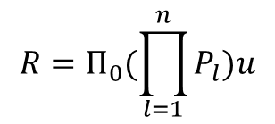
<number>
Markov Chain Imbeddable Structure Technique
A state Sn = <l1, l2, …, lm> where li is 1 if component i is functional and 0 if component i has failed
Π0 is the matrix representing the probability that state Si is the initial system state
The transition probability matrix Pl is defined so that pij(l) is the probability of the system transitioning from state Si to Sj if component l fails
The functionality matrix u is defined so that u[n] is 0 if state Sn represents a system failure; otherwise, u[n] is 1
_{System Reliability is thus}
COMPSAC 2014

Slide 10
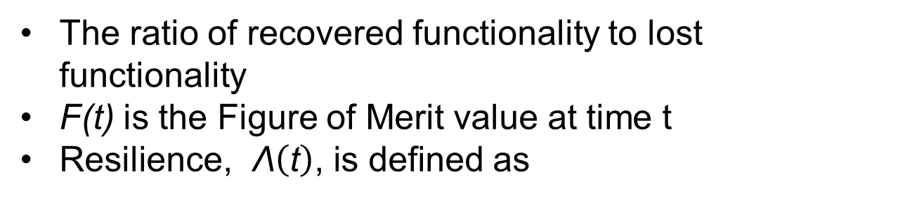
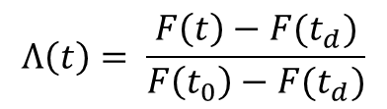
<number>
Resilience
The ratio of recovered functionality to lost functionality
F(t) is the Figure of Merit value at time t
as
COMPSAC 2014

Slide 11
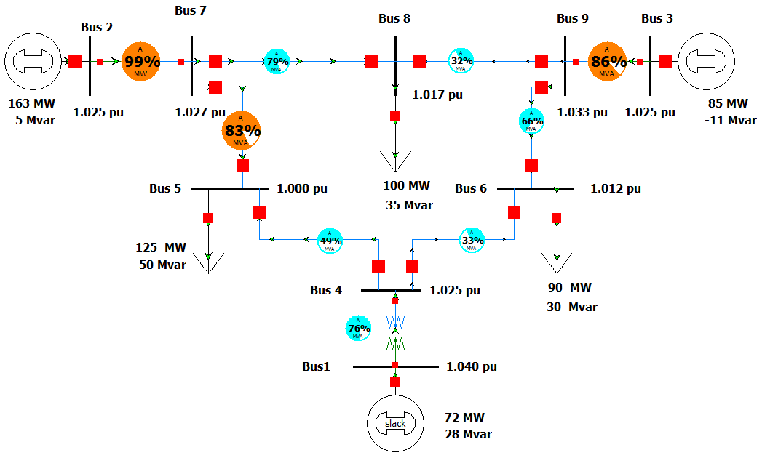
<number>
Case Study
IEEE 9-Bus System
COMPSAC 2014

Slide 12

<number>
Reliability Case Study
Simulated single-line failures on each line
The system is functional if 0 or 1 lines have failed; that is, if a line failure does not trigger a cascading failure, the system is functional
Testing with PSAT determined that failures of lines 2-7, 3-9, and 1-4 caused cascading failures
Let pL = 1 – qL be the probability of a transmission line failing
The system reliability can be represented as
COMPSAC 2014

Slide 13
<number>
Adding a SSSC
Simulated single-line failures on each line
The system is functional if 0 or 1 lines have failed; that is, if a line failure does not trigger a cascading failure, the system is functional
Testing with PSAT determined that failures of lines 2-7, 3-9, and 1-4 caused cascading failures
Let pL = 1 – qL be the probability of a transmission line failing
The system reliability can be represented as
COMPSAC 2014

Slide 14
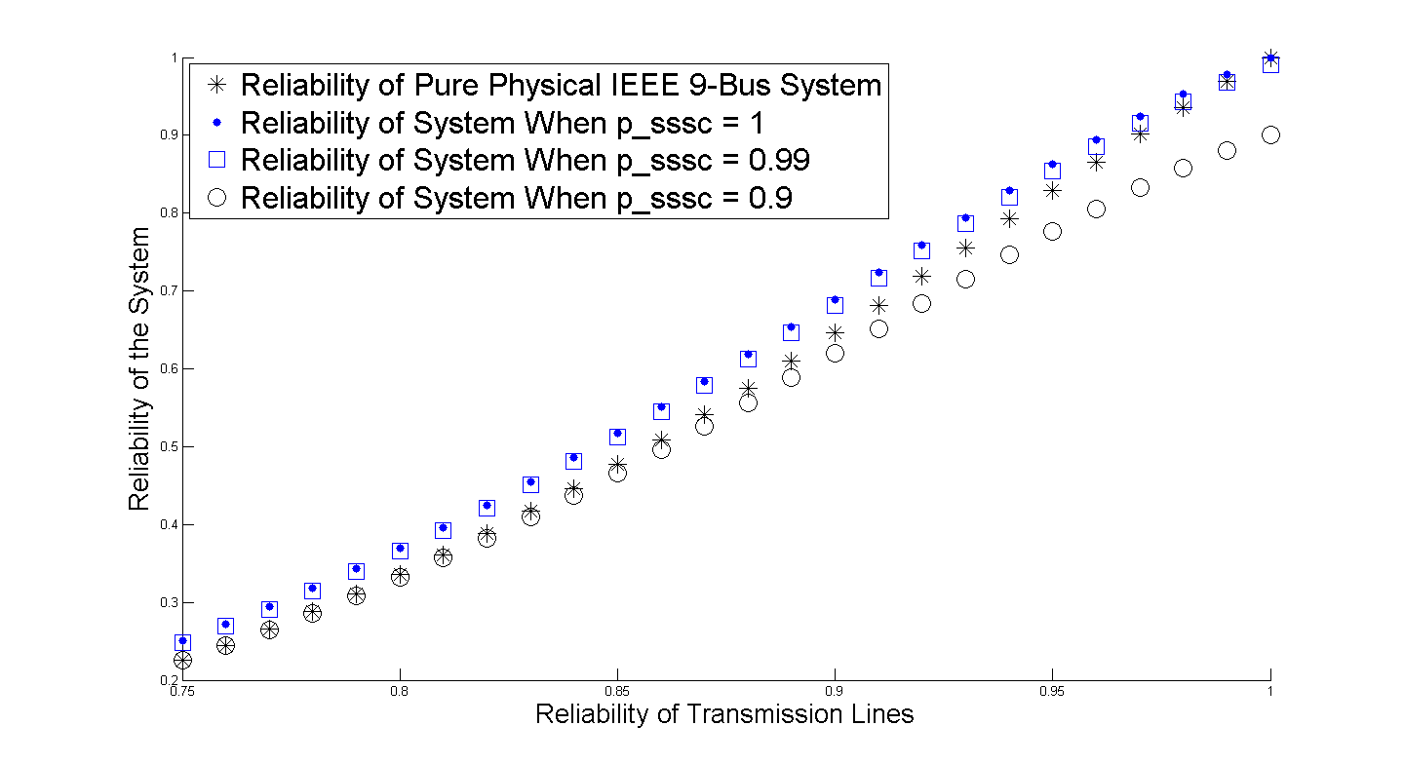
<number>
Effect of SSSC
COMPSAC 2014
Notes:
The tool is tested for functional verification by manually injecting voltages on traces of SD card and corresponding analysis data on host is recorded. Voltage is injected from 2500 V to 4000 V in steps of 500V. For each voltage, 500 pulses are injected. The probes used for testing are ESD Ez-5 and ESD hx-5mm probes.

Slide 15
<number>
Resilience Case Study
Compare two Figures of Merit:
Power Flow on Line 1-4
Voltage on Bus 8
Study the most severe failure: outage of lines 2-7,5-7, and 7-8
Two recovery strategies considered:
Recover lines 7-8, 5-7, and 2-7, in order
Recover lines 5-7, 7-8, and 2-7, in order
COMPSAC 2014

Slide 16
<number>
Recovery Results
COMPSAC 2014
Notes:
The smart scan system is used to hold the probe and move it in 3D space by using the robotic arm. The scanning points can be selected in the smart scan software and the entire process can be automated to scan the desired area on the board. We integrate the register analysis algorithm into the smart scan to obtain location specific information along with the software-based error information. Instead of Labview-based GUI, a Matlab code collects data, controls the smart scan scanning sequence, remotely controls the TLP and resets the board through a data-acquisition device.

Slide 17
<number>
Resilience Conclusions
First FOM (Power Flow on Line 1-4) yields almost identical values for both recovery strategies and cannot be used to compare them
Second FOM (Voltage on Bus 8) yields better values for the second strategy, so it is recommended for recovery from this situation
COMPSAC 2014

Slide 18
<number>
Summary of contributions
Developed a Markovian model for power system reliability quantification
Applied this model to the IEEE 9-bus system, both with and without a control device
Selected metrics for measuring the resilience of different recovery strategies
COMPSAC 2014

Slide 19
<number>
Conclusions
In order to improve power systems with cyber control devices, we must be able to quantify the reliability of the system—its ability to remain functional
In order to recover failed systems, we must be able to determine system resilience—how quickly the system can bounce back from failure
We have demonstrated models and techniques for measuring both reliability and resilience
These techniques can be expanded to many fields, including other critical infrastructures and software engineering
COMPSAC 2014

